Slide 1
BIG DATA IN TELECOMMUNICATION INDUSTRY
BIG DATA MANAGEMENT
WQD170002 – Gunasegarran
WQD170035 - Muhammad Nooraizad

Slide 2
Introduction
For decades, communication service providers have delivered and captured huge volumes of information
There are no effective and efficient way to benefit from the abundance of data. Storing this huge amount of data is costly
Introduction of big data technologies enable telecommunications companies to uncover and gather insight from the data

Slide 3
When the big data technology is needed?

Slide 4
Key Obstacles Faced by the Telecommunication Industry
Handle large volume of data – Transforming, analyzing and integrating the vast amount of data generated by users requires new and advance technologies. The system must be able to integrate data in near real time at minimal cost.
Utilize the variety of data – Telecommunication company should have the necessary capability to transform and analyze data from multiple source and formats whether structured or unstructured data.
Manage the velocity (complexity) of data – Data processing across platforms should be optimized in order to benefit the most from the data. Identifying, masking and managing sensitive data for regulatory compliance should be a systematic process.

Slide 5

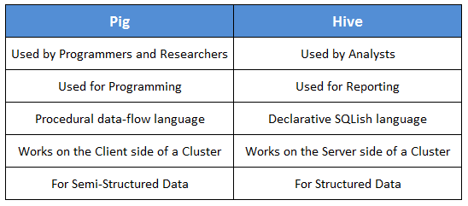
Using Big Data Technology in Telecommunication Industry
Tools and software are used to solve the problems faced by telecommunication company and the most used tool is Hadoop.
Hadoop is an open-source software framework for storing data and running applications on clusters of commodity hardware. It provides massive storage for any kind of data, enormous processing power and the ability to handle virtually limitless concurrent tasks or jobs.
Apache Hive provides a SQL-like interface to data stored in HDP. In the previous tutorial, we used Pig, which is a scripting language with a focus on dataflows. Hive provides a database query interface to Apache Hadoop.

Slide 6
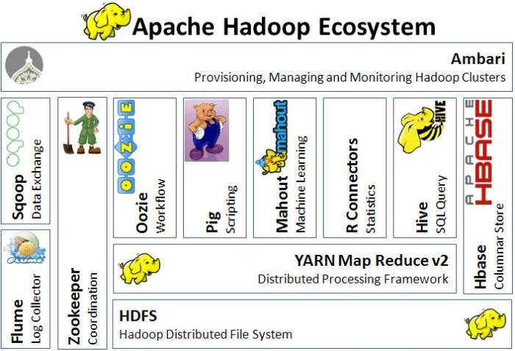

Slide 7
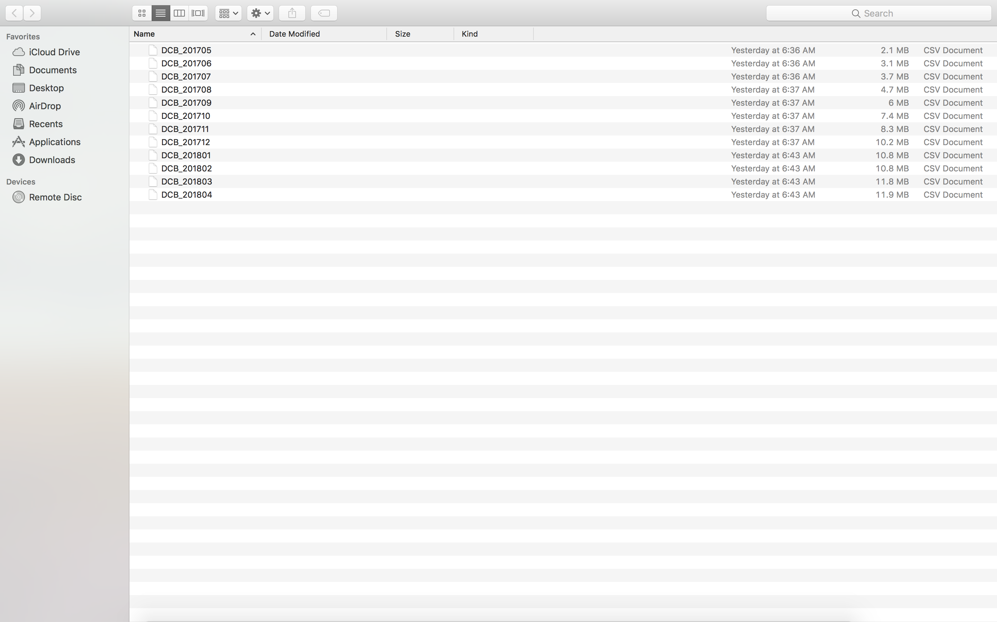
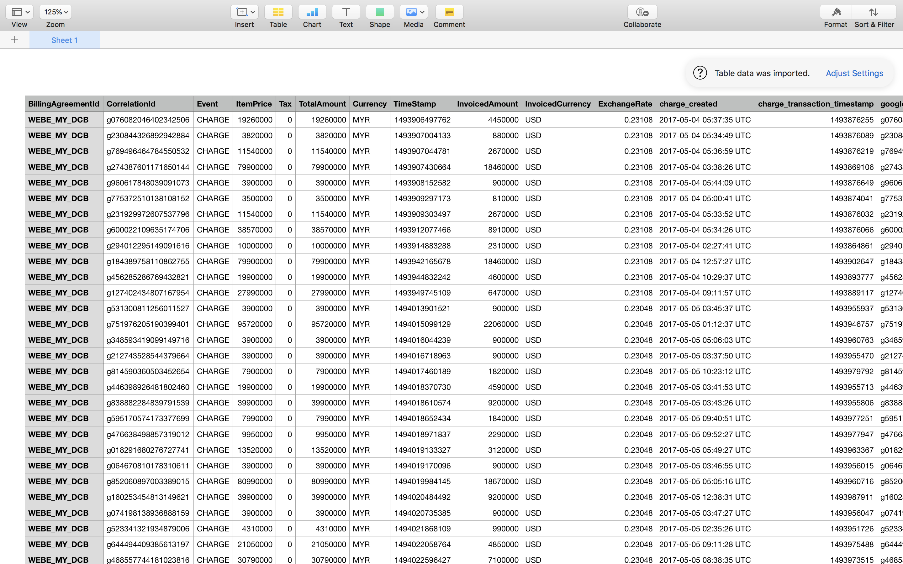
Example of dataset used
Direct Carrier Billing (DCB) – webe digital

Slide 8
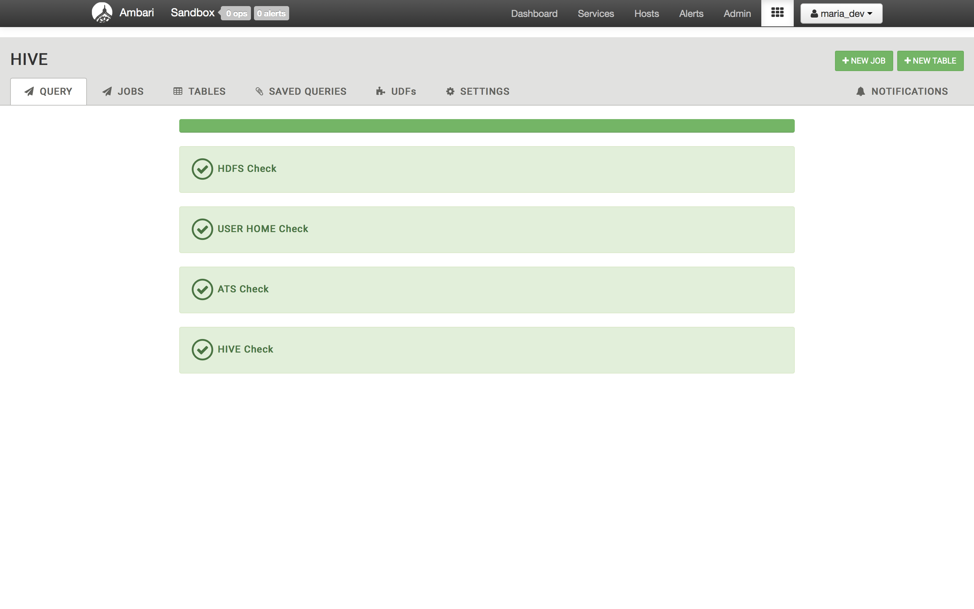
Using Hive in Hadoop

Slide 9
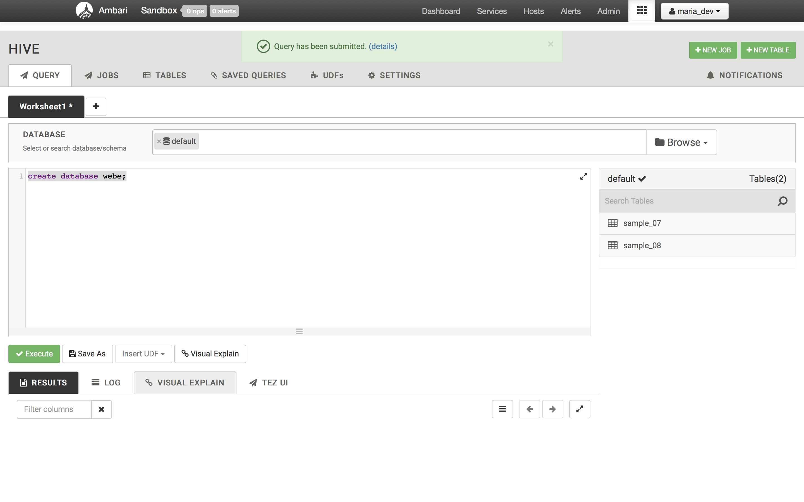
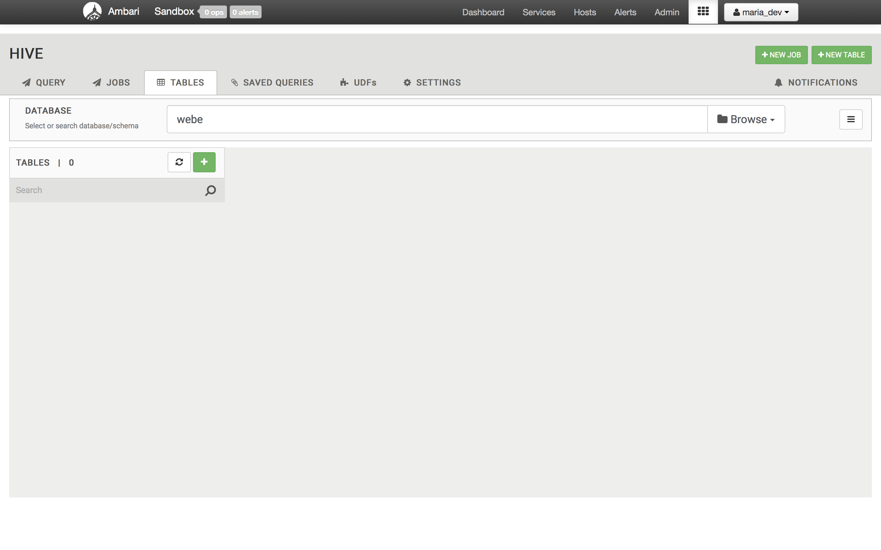
Using Hive in Hadoop to create new database

Slide 10
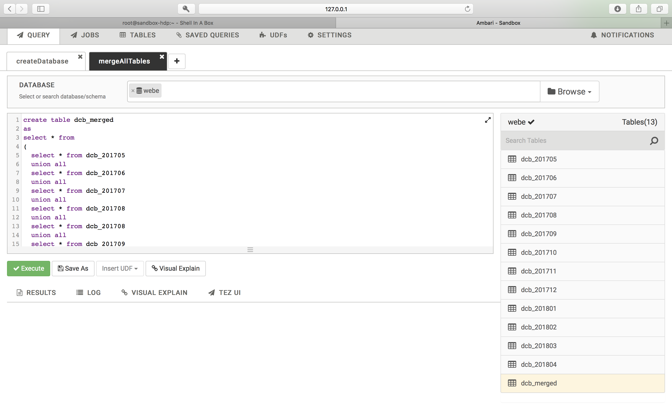
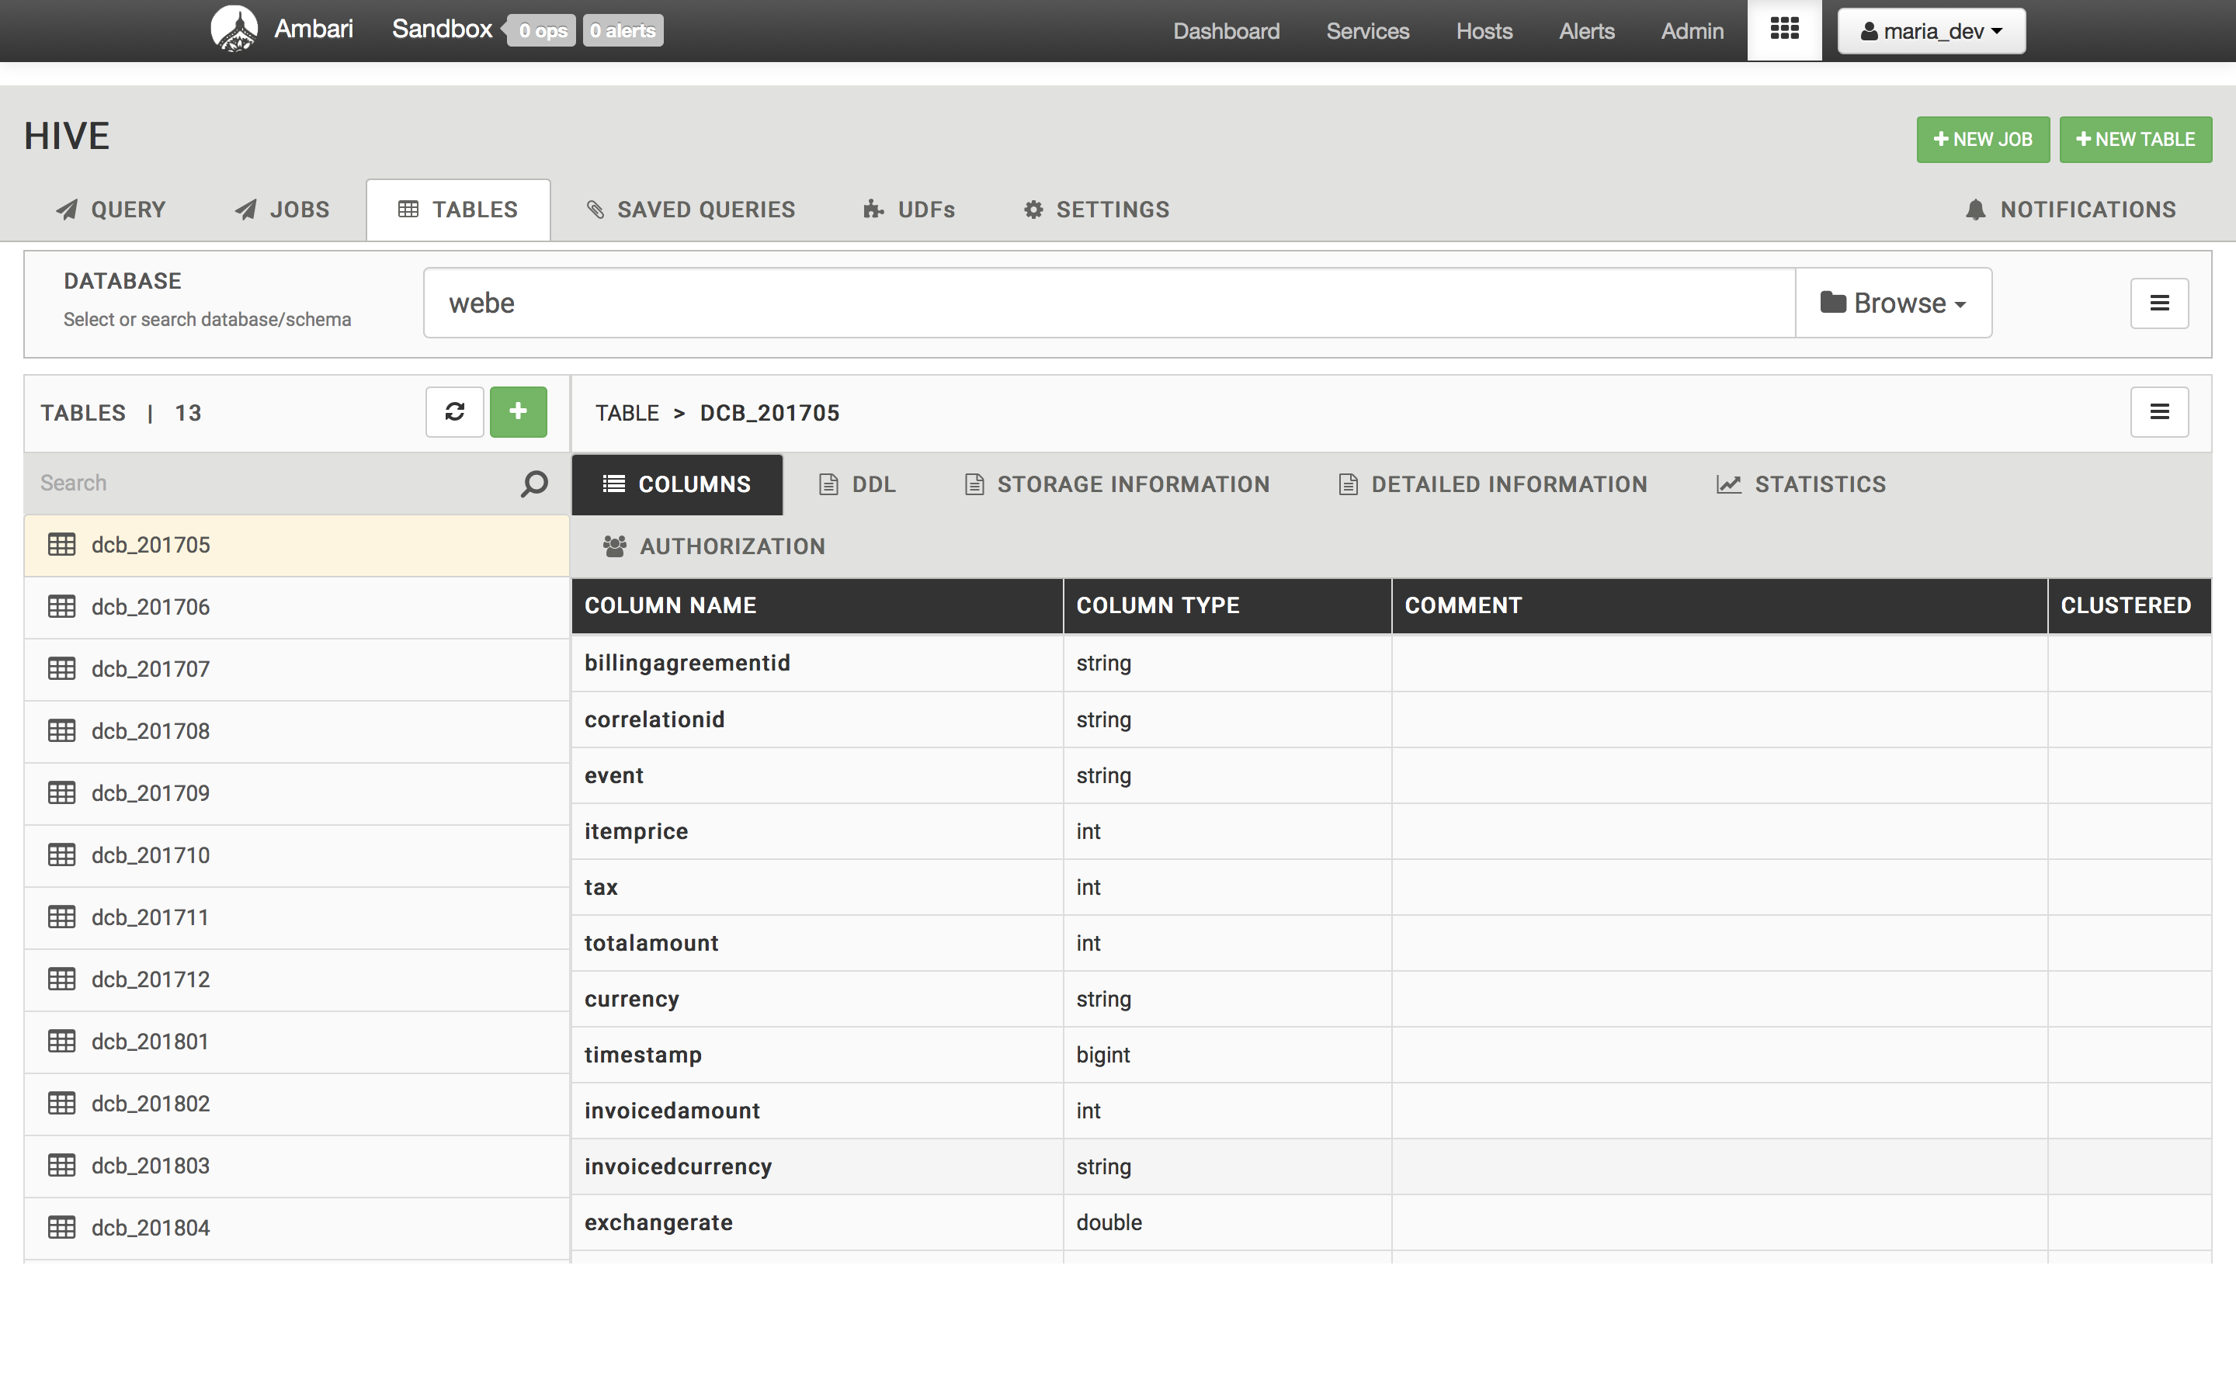
Using Hive in Hadoop insert all the tables records

Slide 11
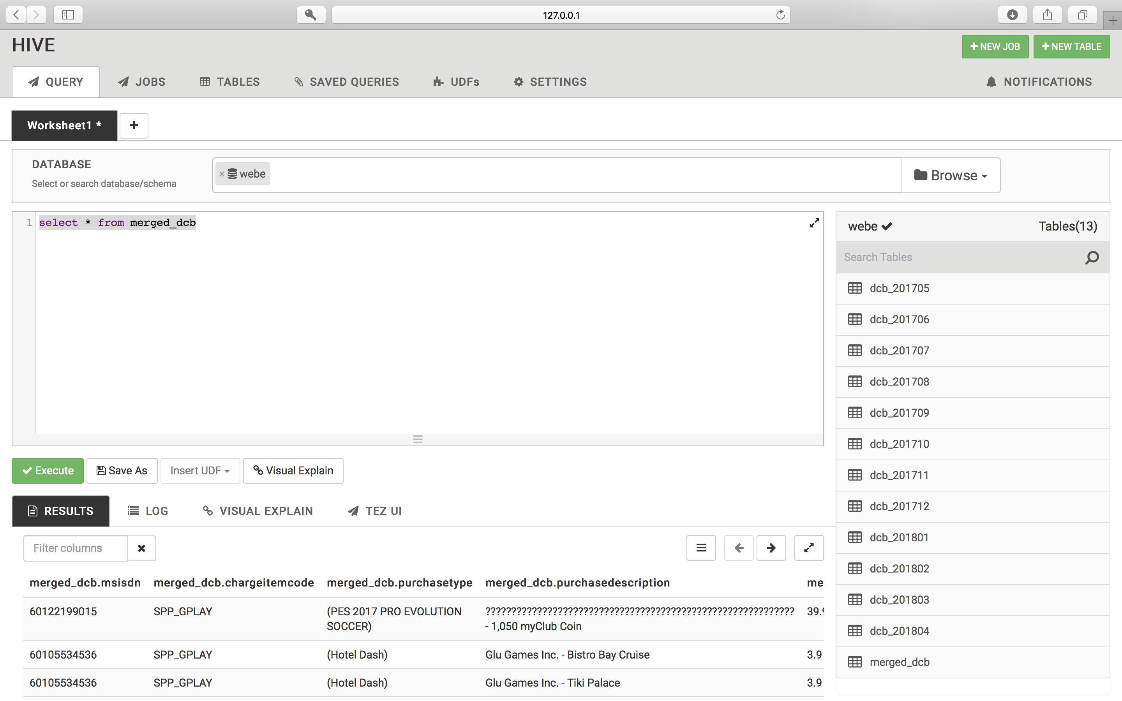
Using Hive in Hadoop to merge all the tables in to one table

Slide 12
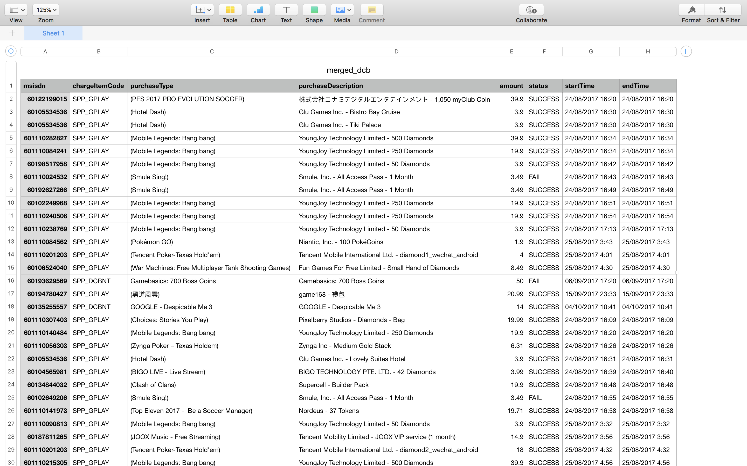
Using Hive in Hadoop to display the merged database

Slide 13
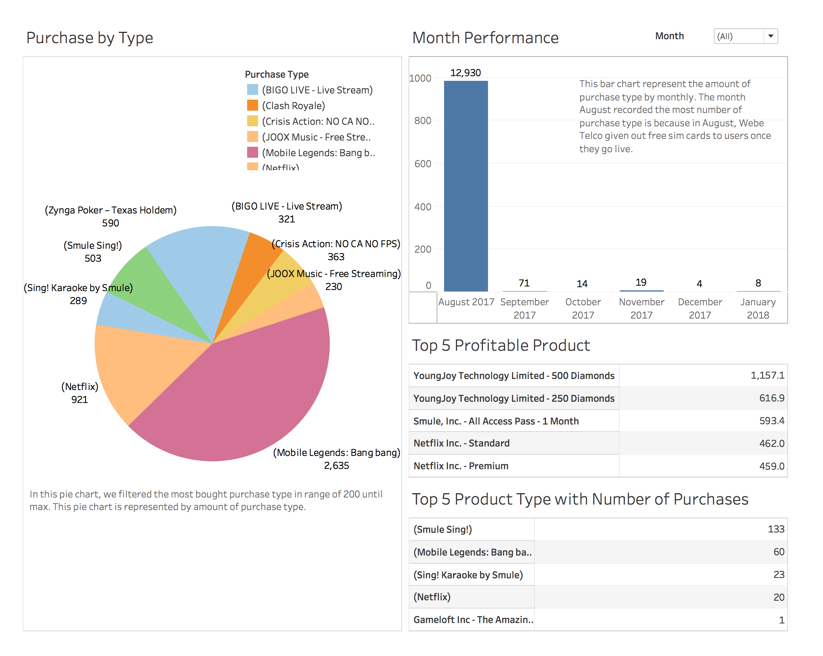
Analysis by using Tableau

Slide 14
Conclusion
By using Hive for analyzing large datasets using Apache Hadoop and HIVE as a back end.
Explained how to join two large datasets to form a correlation dataset. To keep huge amounts of correlation data. How to create a correlation table with partitions, then walked through the best practices for using Hive efficiently and effectively.
Based on this example case, many Malaysian based Telecommunication provider are able to solve their big data problems by using Apache Hadoop and Apache HIVE, while implementing User Defined Function into it.

Slide 15
Reference
BigDataMadeSimple – Baiju NT, 11 Interesting Big Data Cases studies in Teleom. August 2017. http://bigdata-madesimple.com/11-interesting-big-data-case-studies-in-telecom/
Booz & Company, Benefiting from big data, A new approach for the telecom industry. 2013. https://www.strategyand.pwc.com/media/file/Strategyand_Benefiting-from-Big-Data_A-New-Approach-for-the-Telecom-Industry.pdf
Hewlett Packard Enterprise, MTS India relies on HPE Vertica in a highly competitive telecom market. How analytics keeps customers from moving to the competition. November, 2015. https://www.vertica.com/wp-content/uploads/2017/01/4AA5-2844ENW.pdf
IBM Global Service, Analytics: The real world use of big data. How innovative enterprises extract value from uncertain data. October, 2012. https://www.bdvc.nl/images/Rapporten/GBE03519USEN.pdf
Infocepts, Re-engineering a Telecom Market Share Analytical Application. October, 2013. http://www.infocepts.com/pdf/Industries/Telecommunications/Re-engineering_a_Telecom_Market_Share_Analytical_Application-Case_Study.pdf

